Slide 1
Let’s Talk Rocks the Outreach Charts: The Journey 10th Annual Association for University & College Counseling Center Outreach Conference University of Michigan Ann Arbor, Michigan June 8, 2017
Sharon Mier, PsyD; Matthew Boone, LCSW; Wai-Kwong Wong, PhD;
Sudha Wadhwani, PsyD; Jude Uy, PhD; Robin McAleese, MS, CAS, LMHC; Erica Weathers, LICSW; and Megan M. Marks, PhD
Notes:
1
I added music images throughout to be fun and fit with the theme. Please let me know if too hokey!

Slide 2
Agenda
The history, mission, and purpose of Let’s Talk in reaching underserved students and increasing access to support in their cultural worlds… the inception: Cornell University
Let’s Talk journeys at 4 different university settings: Montclair State University, SUNY Oswego, Mount Holyoke College, and University of Kentucky
Logistics of starting Let’s Talk: locations, policies/procedures, marketing, confidentiality, paperwork/documentation

Slide 3
Cornell University…Where it all started…
The history, mission, and purpose of Let’s Talk…
Reaching underserved students and increasing access to support in their cultural worlds
Walking the walk… true culturally competent community intervention
Breaking down the counseling center walls… no longer continuing to privilege the privileged (providing services to only those students who seek traditional counseling services)
Sharon Mier, PsyD; Matthew Boone, LCSW; and
Wai-Kwong Wong, PhD
Notes:
3
This is where we show the videos. We can insert the links on next (new) slide. https://drive.google.com/file/d/0BznLxrfXLRWSbzNpekhVcGRqdnc/view?invite=CN2N-8oC&ts=59316c76
I embedded the link in the lower corner so when you click on the musical note pic, it should come up

Slide 4
Let’s Talk: Origins, Successes, & Challenges
Video: https://drive.google.com/file/d/0BznLxrfXLRWSbzNpekhVcGRqdnc/view?invite=CN2N-8oC&ts=59316c76

Slide 5
The Growth of Let’s Talk… the Journey…
66 sites across the country including at Korea Advanced Institute of Science and Technology - Seoul, South Korea
The various adaptations
LT listserv
LT survey – overview of the data…

Slide 6
The Logistics/Considerations
Choosing locations
Staffing (postdocs, multiple/single staff)
Marketing (flyers, website, social media)
Managing flow (procedures, structure)
Confidentiality/Consent/Info. forms
Paperwork/documentation (Ti clinical/ non-clinical notes; data forms)
Let’s Talk to CAPS transition (walk-in, bridge)

Slide 7
Montclair State University Sudha Wadhwani, PsyD
Jude Uy, PhD
State University in Northern NJ; diverse; first gen; 70% commuter; low income; 21,000 students; under-resourced and limited office space
Started in 2007, following the first annual national outreach conference at University of Michigan 10 years ago.
Grown to 8 sites across campus … 9th in Fall 2017
LT as a bridge and/or walk-in intervention in itself (instead of having walk-in hours at CAPS)
Notes:
Incredibly successful - 484 contacts this past year (up till May 15th)

Slide 8
Montclair State University (cont.)
5 CAPS staff and 2 post-docs on LT team
Building Let’s Talk Campus Partners as stakeholders -strategic selection of locations; becoming a part of campus departments
Administrative buy-in through data, critical incidents, and connection with AUCCCO and Cornell
Increased resources at CAPS to accommodate increase in presenting students; staff buy-in and growth
Differentiating Let’s Talk (as a brand) from CAPS… significantly less stigma for students who would not come to CAPS.
Notes:
One key to the success of the program is the collaboration with our campus partners

Slide 9
SUNY Oswego Robin McAleese, LMHC
One of 12 SUNY comprehensive colleges/64 total in SUNY system. Established in 1861. 8000 total enrollment. Considered primarily residential campus with 13 residence halls/60% of our students live on campus. 2.7% identify as International students and 24% identify as domestic students of color. Counseling Service sees about 10% of overall student population each year.
Let’s Talk began in Fall 2011 in one Residence Hall for 1.5 hours. Fall 2012 expanded to 2 locations for total of 4 hours per week in evening. Currently in 2 Res Halls and one academic building for total of 4.5 evening hours per week.
LT averages 47 students per semester/94 per academic year.
Goal: To provide greater accessibility to students through brief, informal, non-clinical consultations offered in a convenient locations

Slide 10
SUNY Oswego (cont.)
Remains anonymous, no informed consent* no client notes in Titanium unless student or counselor indicates need for consent/documentation due to nature of concern.
Collaborated with Res Life to establish locations that are private yet easy to access and not isolated to ensure counselor safety.
Successful marketing has insured that campus faculty, staff, and administrators are aware of the service.
Notes:
Current Director wishes to formalize policy about LT client notes/documentation. I remain committed to anonymous use/counselor judgement about use of informed consent.
Access to locked buildings after hours can be a concern
Anecdotally I see many off-campus students.
Staffed by me (LMHC) and a part-time counselor. I receive flex time and meal support from Res Life

Slide 11
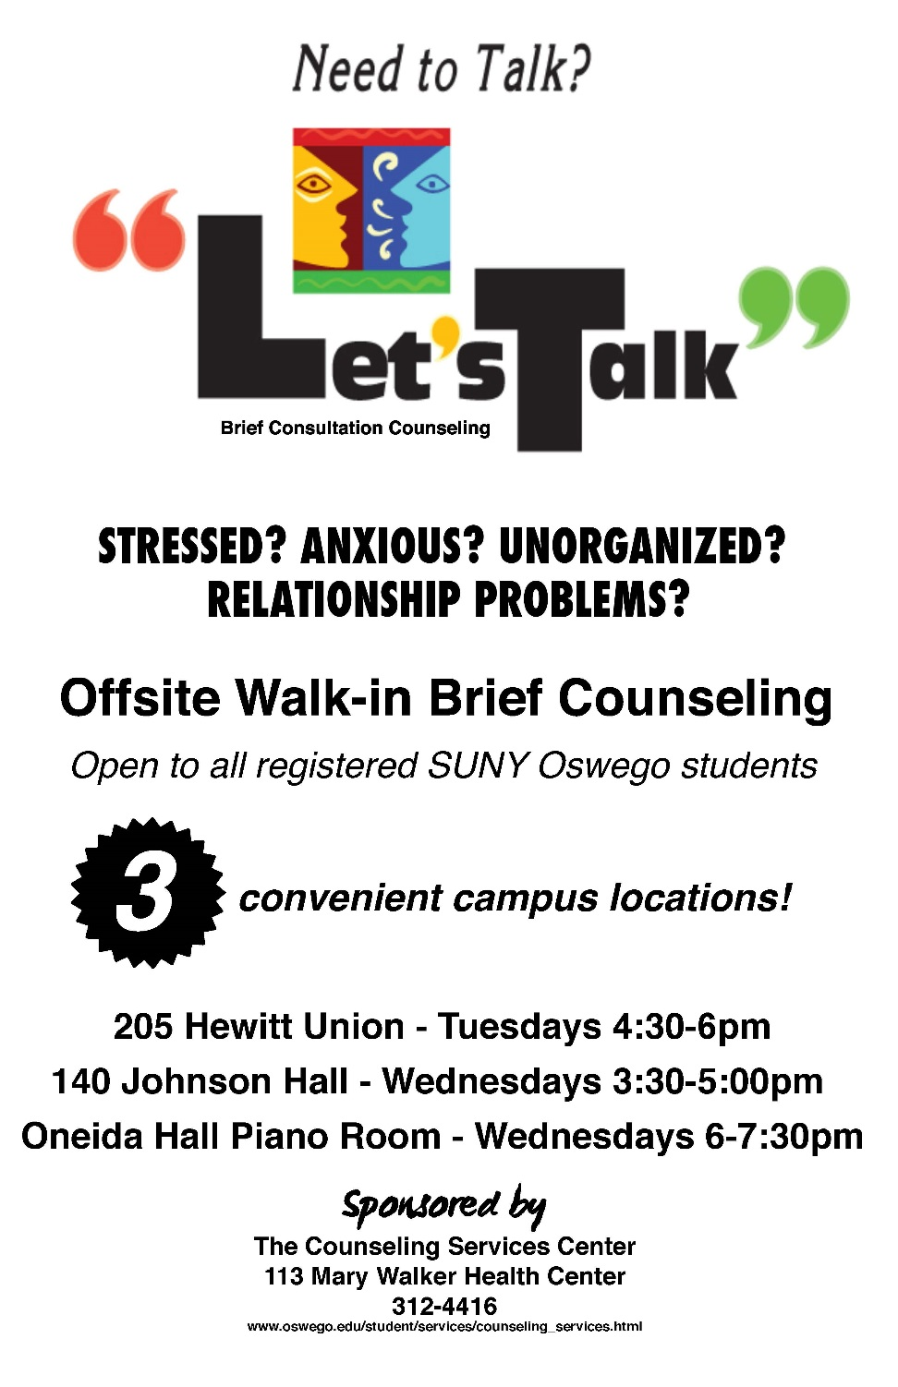

Slide 12
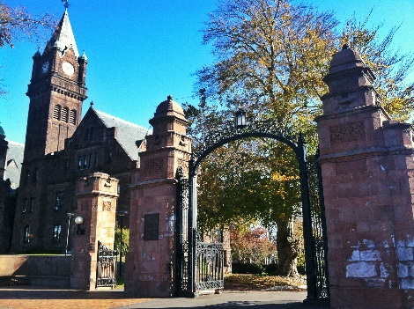
Mount Holyoke College Erica Weathers, LICSW
Mount Holyoke College is a historically, all women’s liberal arts college in Western Massachusetts; 2,200 students: 27% identify as international students; 27% identify as domestic students of color; primarily residential (98% live on campus)
Counseling Service is in contact with 36% of student population each year
Drop-In Talkin’ (modeled after LT) began in Spring 2016
One drop-in site located in the student campus center offers 2 hours 2 times per week
Total number of contacts in 2016-17 academic year: 133: highlighted STATS: 65% students seen in drop-in followed up with CS; nearly 40% of students began engaging in therapy for the 1st time; 30% of students identified as Asian/Asian American
Notes:
STATS: Only saw 12% international - below our targeted goal (CS saw 20%) - 8% Black/AA (almost double what is seen in CS); 4% Latina/o/x
77% of first time users followed up with CS
35% were 1st year students
Majority of students learned about DT through flyers (mailboxes, res hall, and campus center)

Slide 13
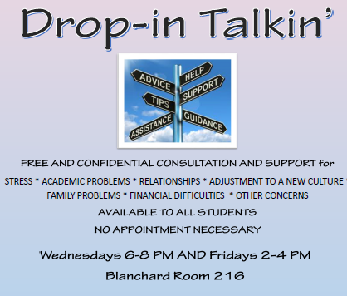
Mount Holyoke College (cont.)
Staffed by 4 rotating staff members which included permanent, licensed staff psychologists and clinical social workers AND pre-licensed post-graduate MSW and post-doctorate psychologist
Successful collaboration throughout Division of Student Life and with student orgs such as Active Minds, Peer Health Educators, cultural centers, and SGA
Consistent, central location and hours (both daytime and evening)
Use of Titanium to log non-clinical notes
Use of survey and track demographics for students to collect data
Survey highlights: (48% response rate)
80% of respondents accessed DT due to anxiety/stress
90% of respondents were satisfied with their experience
97% of respondents agreed that DT is an important resource at MHC

Slide 14
University of Kentucky Megan M. Marks, PhD
UK has 30,000+ students:
75% Caucasian, 12% first generation students, high amount of Appalachian students, 67% in state students
Began walk-in Crisis/IA 2014, Evening hours 2016
Let’s Talk began in Fall 2016
4 Locations Fall and Spring; Piloted 6 locations Total
2 hours, 4 days a week, 11am-5pm
Staffed by 4 permanent licensed staff members w/ back-ups
Central campus (both semesters), Minoritized students , Medical Campus (both semesters)
Notes:
6% international students, 7%Black students, Hispanic/Latino 4%, Asian 3%, 6,500 graduate students
Fall: The 90 (central) , MDS building (medical campus & DRC), Blazer (MLK and LQBTQ), CARES (first gen, scholarship/academically at-risk)
Spring: The 90, The Study, MDS, International Center
Chose not to use residential halls

Slide 15
University of Kentucky (cont.)
Paperwork:
Short informed consent, “confidential conversation”
Use Titanium for non-clinical data form
Did not track demographic data
Total contacts in 2016-2017: 45
50% Stress, 32% Academics, 28% Depresion, 25% Adjust.
65% referred to UKCC;32% no referral
85% appts 30 mins or less
Challenges:
Roll out/Advertising
Benefits:
Class assignments/interviews
Connection to campus partners
Notes:
Data form includes: attended LT before, length of contact, interview or class assignment, topics (used CLICC), where referred.
Began tracking location attendance in spring on data form.
Locations: 90 (5,6), MDS (5, 8), Blazer (9), Cares (1), Int’l (6), Study (3)
Tracked interview data in spring (3).

Slide 16
LT Survey Data 2016-17 Highlights
19 out of 65 schools responded (majority are public institutions)
Largest school: University of Washington @ 46,000 Smallest school: Mount Holyoke College @ 2,200 (majority are large 10k+)
Majority of respondents offer between 6-8 hours/week
Academic stress and anxiety are the most common reasons why students access drop-in
Most common goals for LT/drop-in: To reach students underrepresented in the CS, (primarily SOC and international students), and provide greater accessibility to treatment for students
Most respondents (83%) believe they are reaching their goals with LT/drop-in
Most common barriers: Location and marketing
Most helpful in development: Campus partners and LT listserv
Notes:
Cornell and Montclair are highly successful - over 450 contacts last year (455 and 484 respectively)

Slide 17
Challenges & Barriers
May serve as the walk-in service for CAPS
When emergencies arise (no triage… no idea what you will get)
Managing flow (handling students waiting)
Potential isolation when outside of CAPS walls
Joining other departments as a guest (this could be great while also having some challenges)
Determining how LT integrates with CAPS clinical services (triage, intake, dispo)
Documentation/confidential information outside of CAPS walls

Slide 18
Opportunities
Reaching students who have not come to CAPS
Collaborating with campus partners/departments
Increasing reach and access
Expanding office space outside of CAPS building
Offering an alternative type of support for student who frequently no-show or do not fit the traditional therapy model
Offering a follow-up option for students who have completed short term therapy

Slide 19
Benefits of AUCCCO and Cornell Connection
Outreach listserv; Let’s Talk listserv
Standards, best practices, legitimacy, connection
Let’s Talk as a bridge between outreach and clinical worlds… increasing access to support and providing critical prevention/intervention

Slide 20
Closing Discussion
Thoughts, reactions, experiences…
How could this apply to your university?
How to further reach out to underserved groups?

Slide 21
Presenters: Contact Information
Sharon Mier, PsyD
Clinical Psychologist in private practice, New York
srm24@Cornell.edu
Matthew Boone, LCSW
Lyra Health, University of Arkansas at Little Rock School of Social Work
matthewboone@gmail.com
Wai-Kwong Wong, PhD
Cornell University, New York
ww46@cornell.edu
Sudha Wadhwani, PsyD
Montclair State University Counseling and Psychological Services (CAPS), New Jersey
wadhwanis@montclair.edu
Robin McAleese, MS, CAS, LMHC
SUNY Oswego, New York
robin.mcaleese@oswego.edu
Erica Weathers, LICSW
Mount Holyoke College Counseling Service, Massachusetts
eweather@mtholyoke.edu
Megan M. Marks, PhD
University of Kentucky Counseling Center
Megan.marks@uky.edu
Jude Uy, PhD
Montclair State University Counseling and Psychological Services (CAPS), New Jersey
uyj@montclair.edu

